Slide 1
Lab 06 Using Selection Widgets and Debugging
By
M.Zakir Khan

Slide 2
As the name suggests, selection widgets refers to the group controls that display a list of choices from which user select items. To constraint user to enter the correct data type or within a specific range and also to show the valid values, lists and dropdown list are commonly used in application. Lists and dropdown lists are called Listview and spinner controls in Android We will also discuss AutoCompleteTextView and GridView

Slide 3
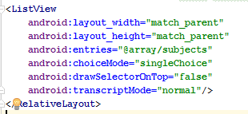
Using ListView
A listview is used to display a list of vertically scrolling items, allow users to select one or more of them. Several attributes can be used to configure this control. Some of them are listed in
Android:entries (refer an array for displaying options in Listview)
Android:choiceMode (used to define number of items that are selectable from the Listview which are none, singlechoice and multiplechoice)
Android:multipleChoiceModel (allow selection of more than on item in custom selection mode)
Android:drawSelectorOnTop
Android:transcriptMode

Slide 4
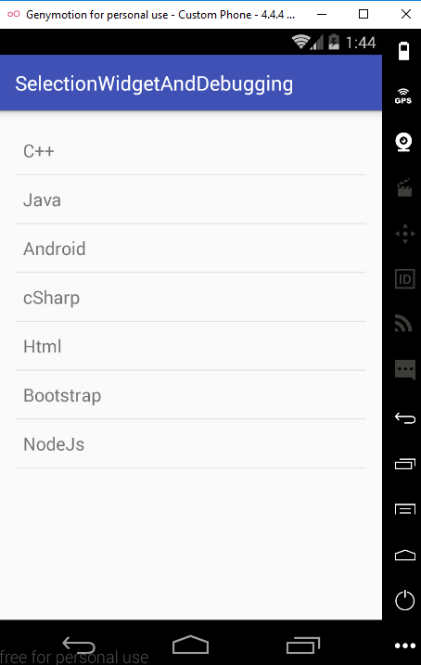
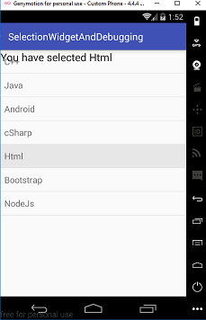
ListView View

Slide 5
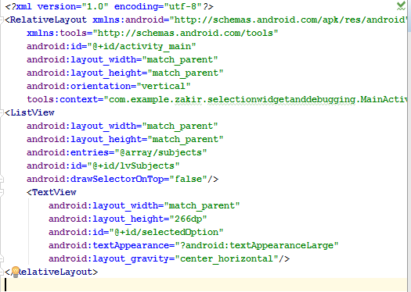
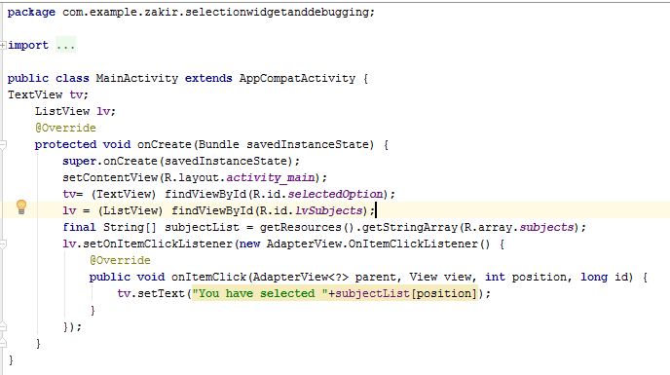
XML CODE Java Code

Slide 6
Adapters
Android provides a framework of adapters also known as data adapter.
The adapter serve two purposes
First they provide the data source for a selection widget
Second they convert individual elements of data into specific Views to displayed inside the selection widget
It cast the data to suit the selection widget environment
Android provides many basic adapters such as ListAdapter, ArrrayAdapter and CursorAdapter.

Slide 7
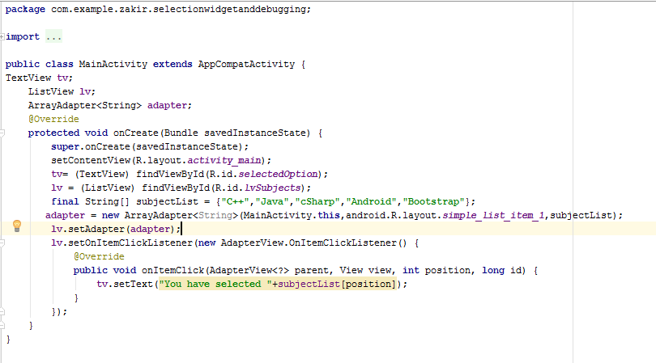
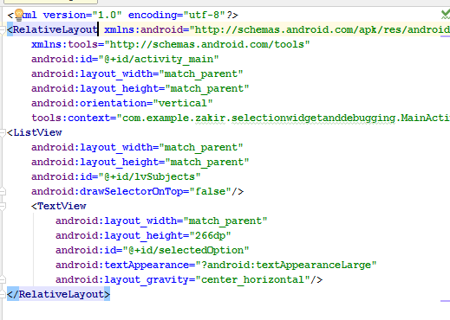
Populating ListView through ArrayAdapter

Slide 8
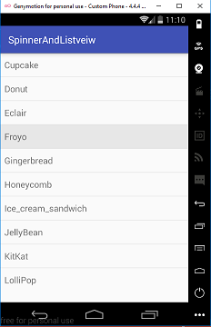
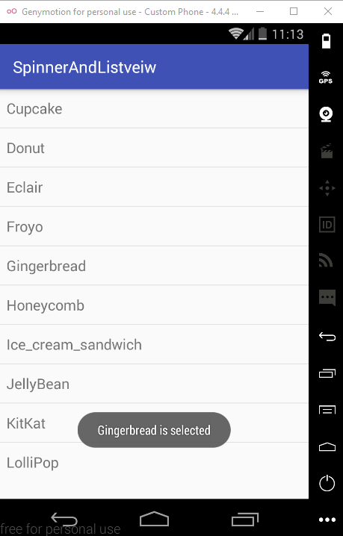

Example 2 on listView

Slide 9
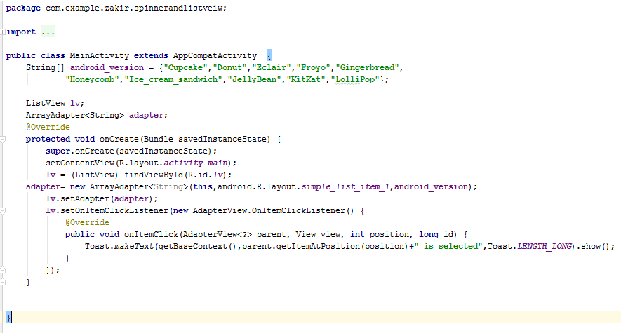
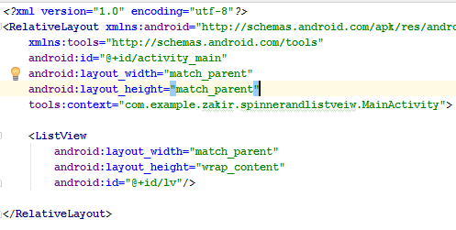
XML and Java Code

Slide 10
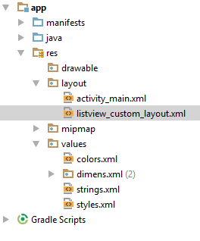
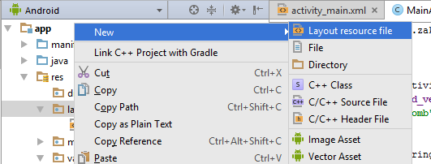
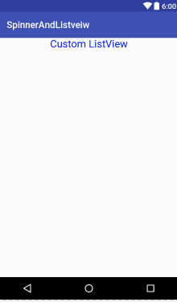
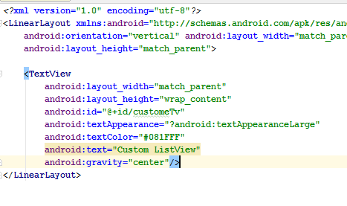
Example 3 Customized ListView
First of all make another separate layout by click right-click on Layout folder and give a meaningful name

Slide 11
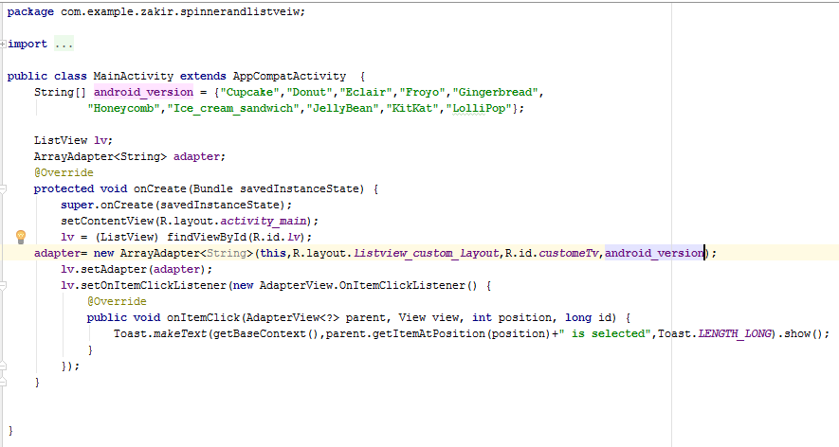
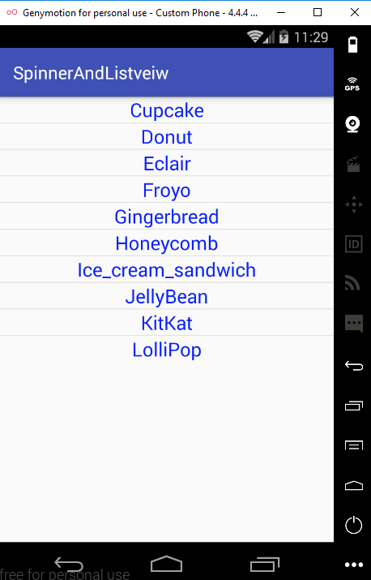
Example 3 Java and Layout View
Second is to make the predefined method of calling arrayadapter to own accessing method like

Slide 12
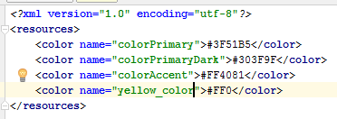
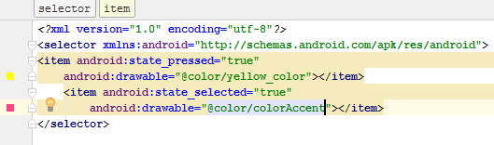
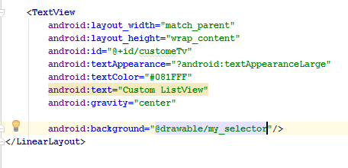
How to Highlight the selected Item on ListView?
First of all Right Click on drawable folder and make a folder by your own name choice and I have given the name here my_selector.
I have define color in color.xml file and make item in my_selector.
Now make changes in CustomeListview by adding background like

Slide 13
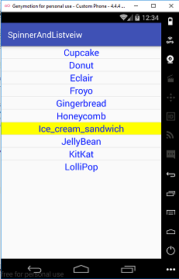
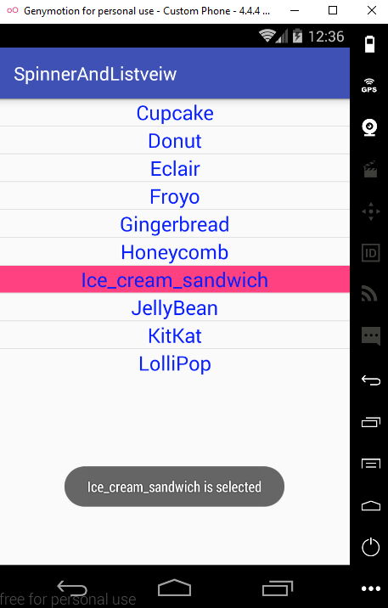
Effect
When Pressed it become yellow and when released it become red

Slide 14
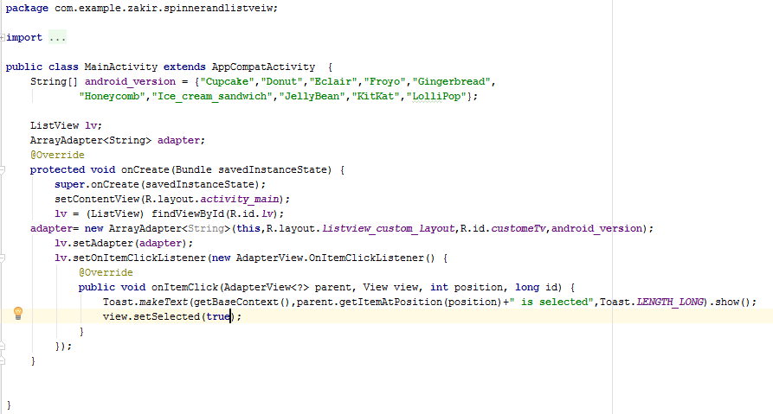
Java Code with little modification

Slide 15


Android.R.layout.simple_list_item_single_choice
Android.R.layout.simple_list_item_multiple_choice

Slide 16
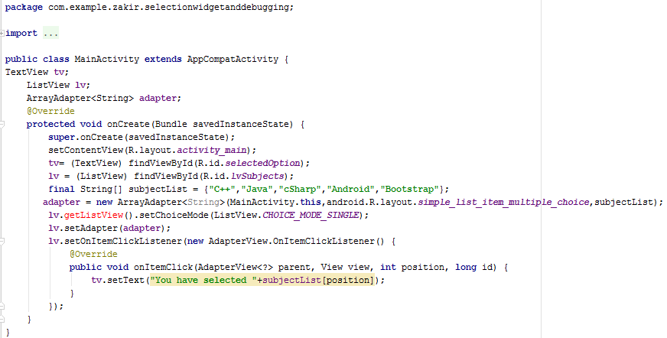
Java Code

Slide 17
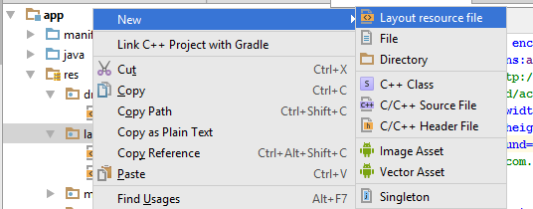
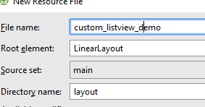
Customized Listview with ArrayAdapter

Slide 18
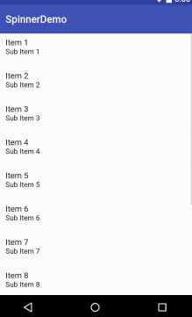
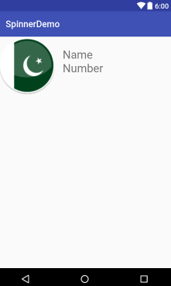
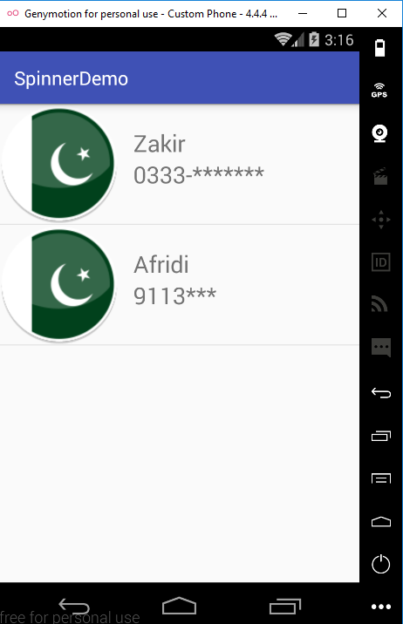
Customized Listview Example 1
The left side is the original default Listview and the Right side is the customized Listview having One image and two Textview

Slide 19
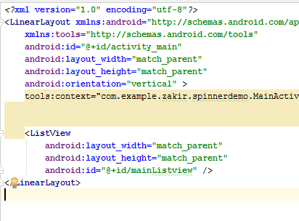
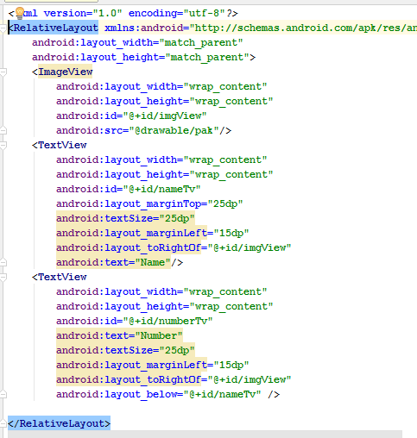
XML layout of default and Customized

Slide 20
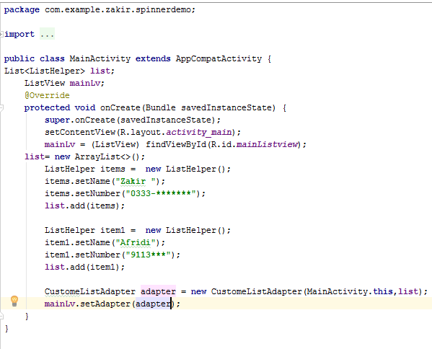
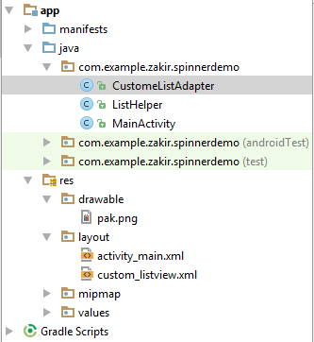
MianActivity.Java

Slide 21
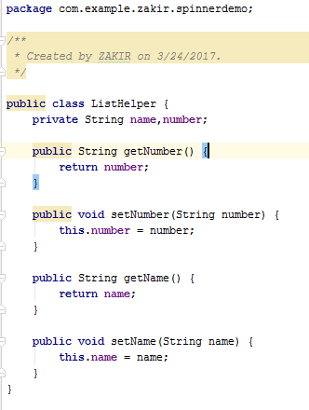
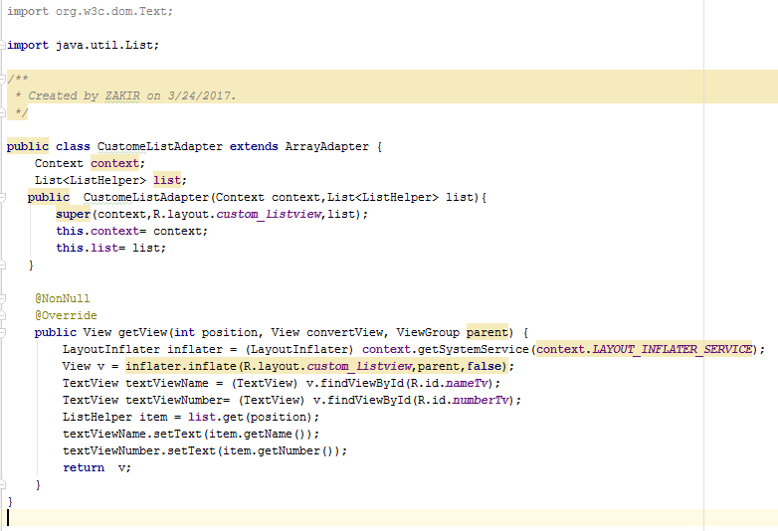
ListHelper class and CustomeListAdapter Class

Slide 22
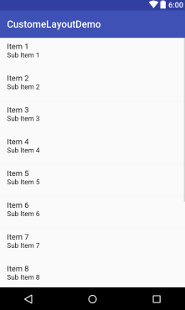
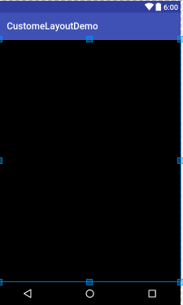
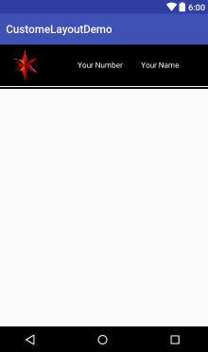
Custom ListView Gui Example 2

Slide 23
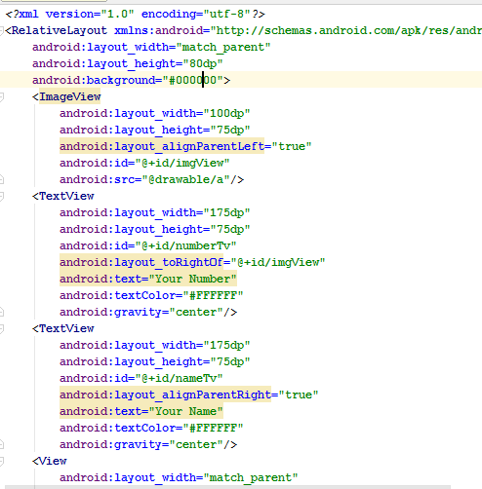
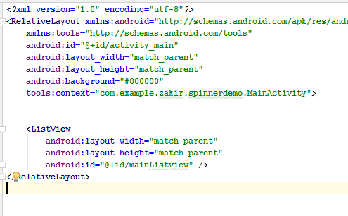
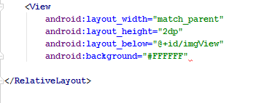
Custom ListView Gui Example 2 XML Code of Left and Right Layout

Slide 24
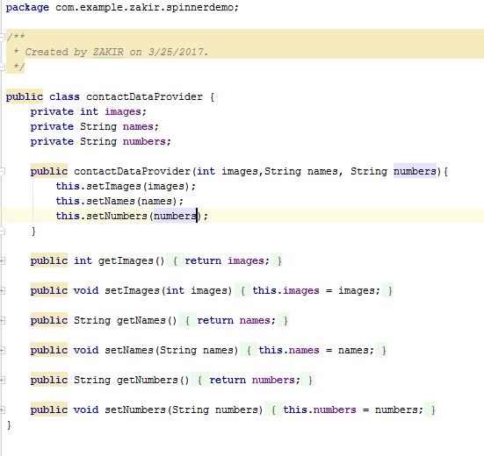
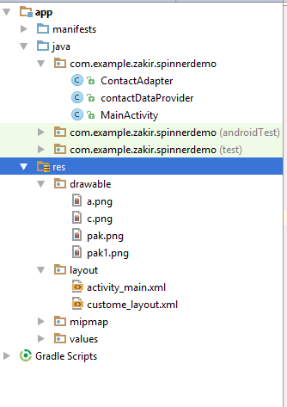
Custom ListView Gui Example 2 ContactDataProvider Screenshot

Slide 25
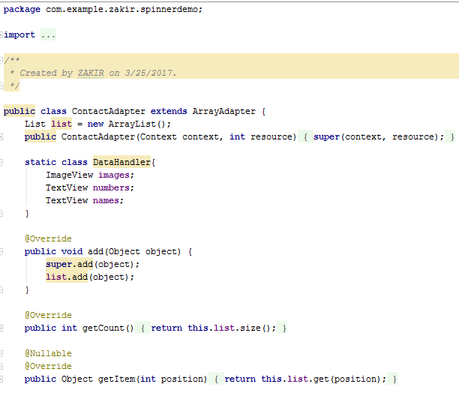
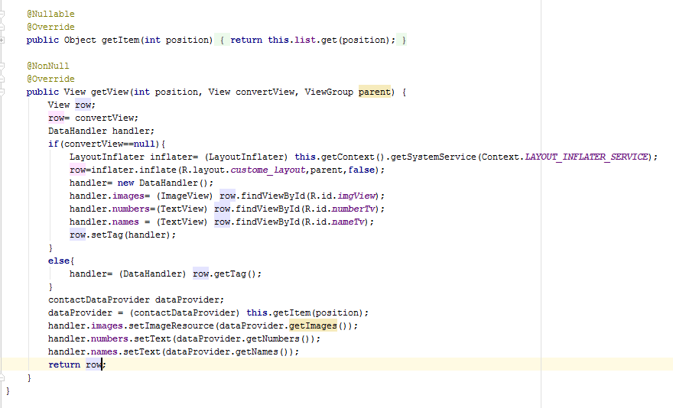
Custom ListView Gui Example 2 ContactAdapter Screenshot

Slide 26
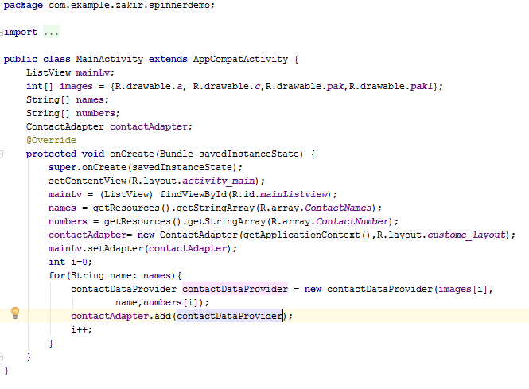
Custom ListView Gui Example 2 MianActivity Screenshot

Slide 27
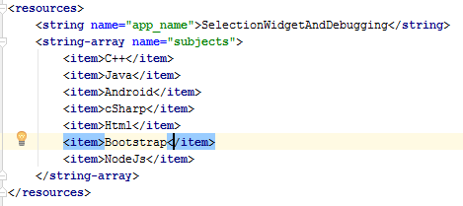
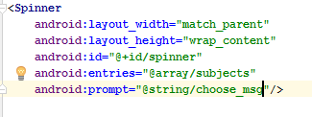
Using Spinner Control
The spinner is like a drop down list that display at list of items, allow user to select the desired item.
To populate the spinner control we use two methods one via the string resources and the other via the arrayAdapter that acts a data source.
Now Populating a spinner through Resources

Slide 28
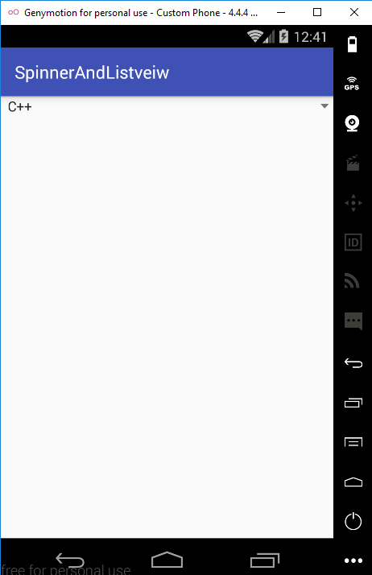
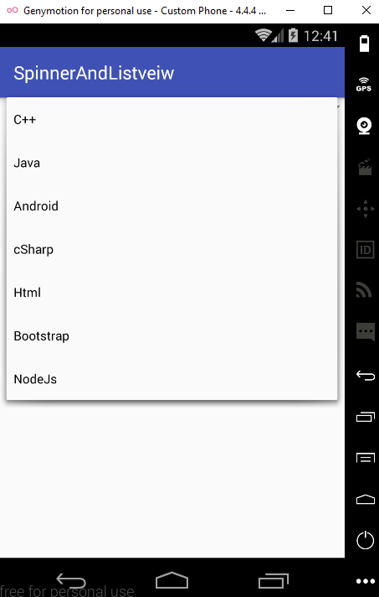
Spinner View

Slide 29



Example on Spinner

Slide 30


XML and Java code

Slide 31

Populating a Spinner through ArrayAdapter
Before going to populating the spinner control with arrayAdapter, we make it empty by removing the android:entries=“@array/subjects” attributes from the xml definition of spinner control in the layout file.
Afer removing the entries attribute, the elements of the subjects string array are no longer displayed in the spinner control.

Slide 32


Xml and Java code

Slide 33



Using Java Code

Slide 34





Calling string-array through arrayAdapter

Slide 35

Java Code

Slide 36



Example 2 using ArrayAdapter

Slide 37


XML and Java Code

Slide 38



Two spinner example

Slide 39


XML and String

Slide 40

Java Code

Slide 41

Java Code continuee

Slide 42





Spinner Populating through Edittext

Slide 43



Slide 44
AutoCompleteTextView
The AutoCompleteTextView control is an EditText control with auto-complete functionality. As the user types, suggestion based on the entered characters appear.
The user can select any of the displayed suggestion to fill in the EditText control.
We will use simple_list_item_1 or simple_dropdown_item_1

Slide 45




Slide 46


XML Code and Java Code

Slide 47

Using GridView Control
The GridView control is the viewGroup control used to display text and image data in the form of rectangular, scrollable grid.
We first define a Gridview control in the XML layout, and then bind the data that we want to be displayed to it using the ArrayAdapter.
Android:numColumns=“auto_fit” (define the numbe of columns)
Android:columnWidth (define width of each column)
Android:stretchMode (Whether the column can stretch?)
Android:verticalSpacing and Android:horizontalSpacing
(define amount of spacing between the item in the grid)

Slide 48



Slide 49


XML Code and Java Code

Slide 50
Displaying Images in GridView
A scrollview is a special type of control that set up a vertical scrollbar in a view controller.
This control is used when we try to display Views that are too long to be accommodated in a single screen.
The scrollview can have only one child view, so usually a view container layout is used as a child when in turn contains other child controls that we want to scroll through.
Note
To display images on devices of different sizes and resolutions and to ensure that your app looks great on any device, the 96*96px, 72*72px, 48*48px and 36*36px images with resolutions of 320 dpi, 240dpi,160dpi and 120dpi respectively are copied into the res/drawable-xhdpi, res/drawable-hdpi, res/drawable-xhdpi folders respectively

